Slide 1
Getting Started with NLP
Raghav Bali

Slide 2
Agenda
Introduction
Language and Its Complexities
What is NLP
Why do we need NLP
Applications
NLP Workflows
Quick Hands-on
Brief : NLP & Deep Learning

Slide 3
Raghav Bali
Optum
Springboard
Author

Slide 4
What is NLP
Intersection of Linguistics, Computer Science and AI
Train Algorithms to process, analyze, understand and model large amounts of natural language data

Slide 5
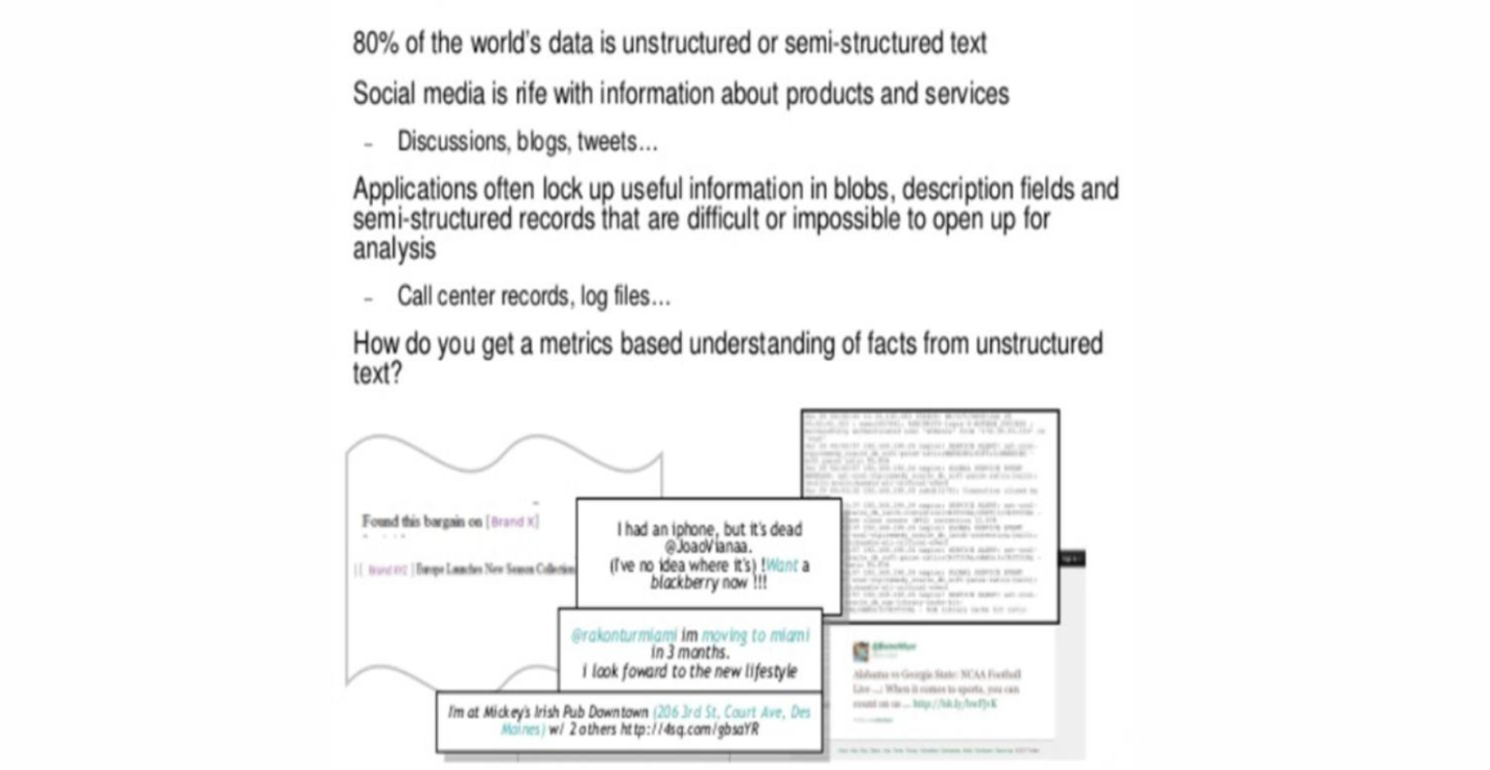
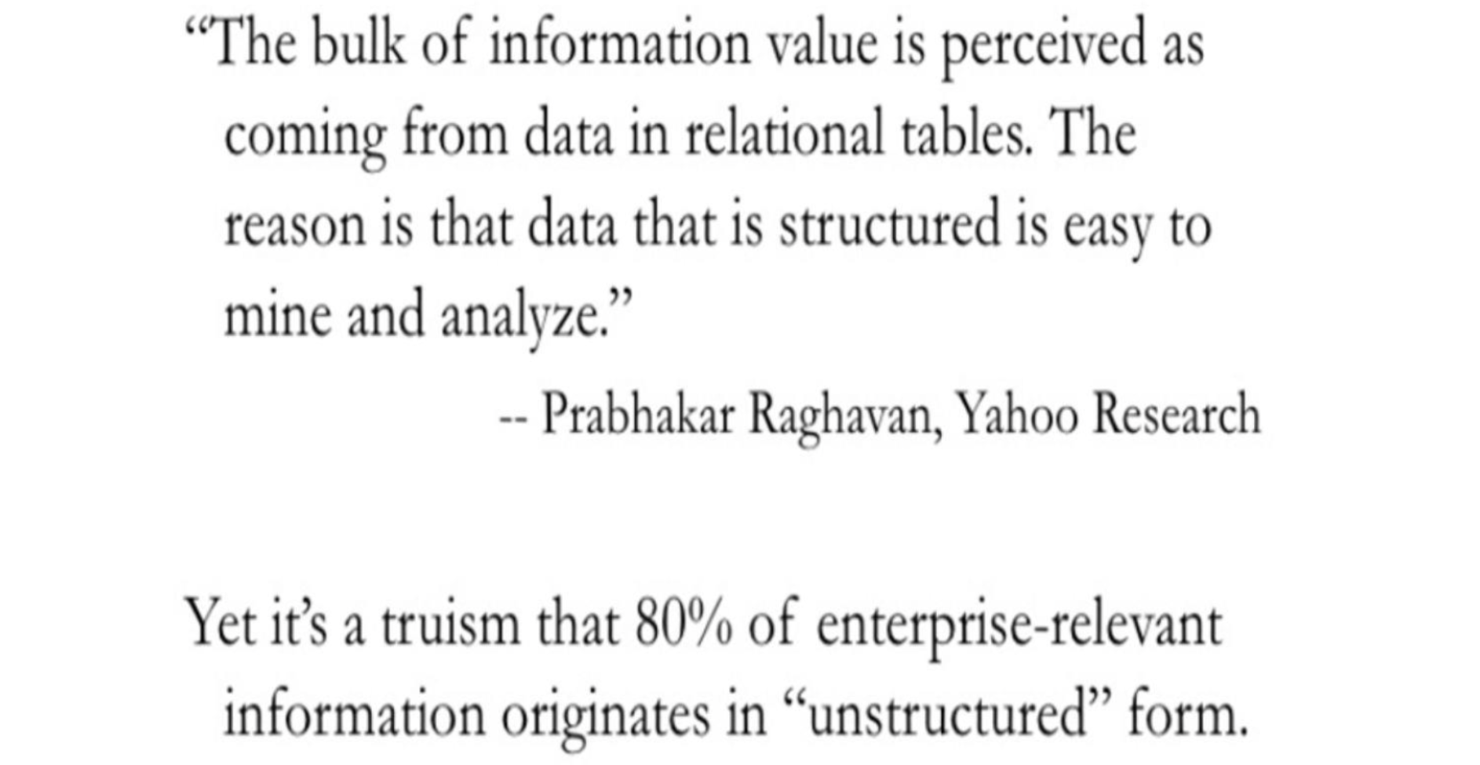
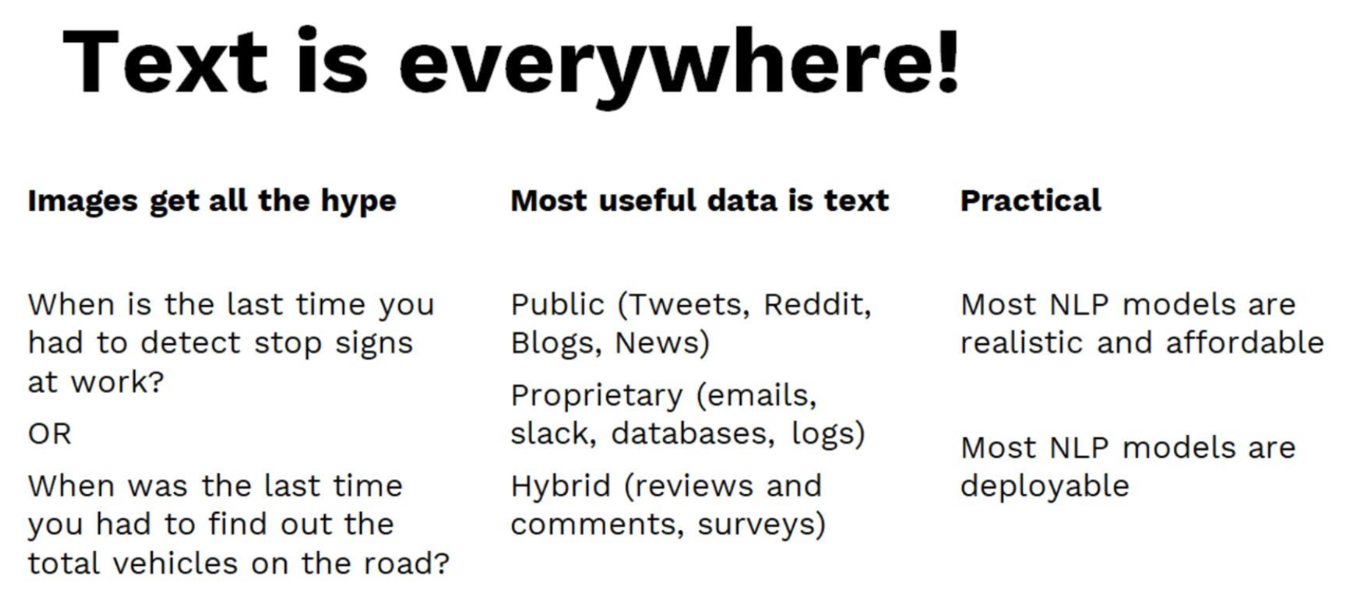
Why do we need NLP

Slide 6
Why do we need NLP

Slide 7
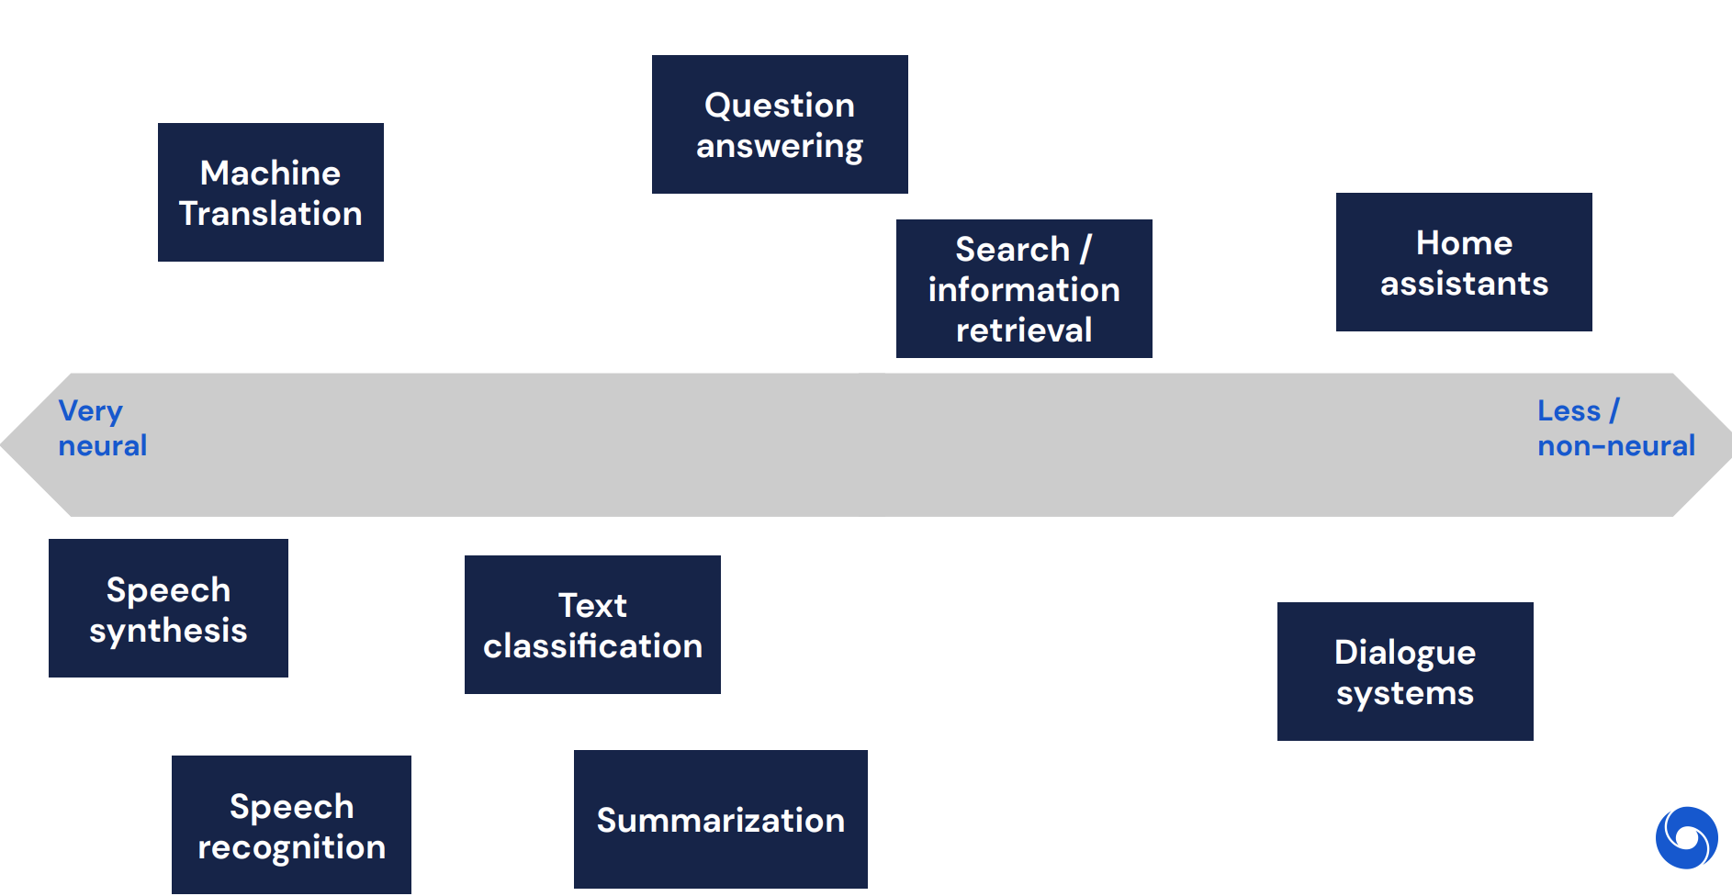
Applications

Slide 8
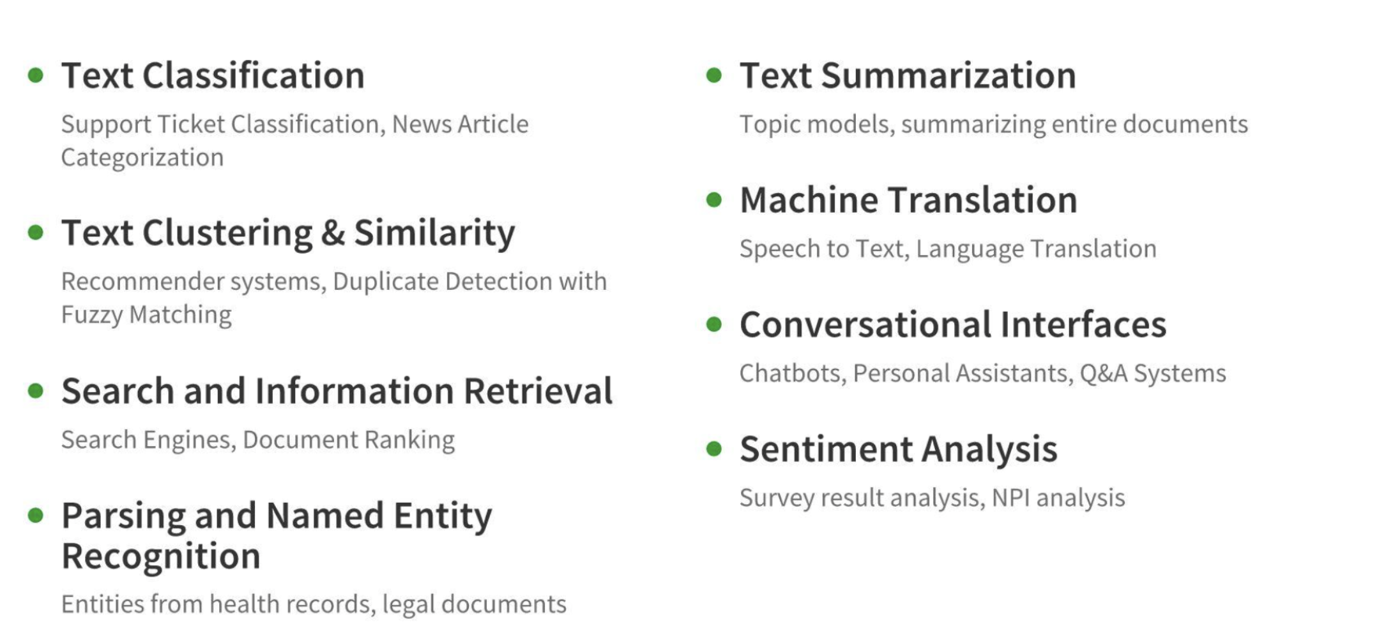
Applications

Slide 9
Language and Its Complexities
Language is one of the most complex aspects of our existence. We use language to communicate our thoughts and choices
Every language is defined with a list of characters called the alphabet, a vocabulary and a set of rules called grammar
Languages are complex and have fuzzy grammatical rules and structures.
Machine learning and deep learning algorithms in general work with numbers, matrices, vectors and so on

Slide 10
Language and Its Complexities
How can we represent text for different language related tasks?

Slide 11
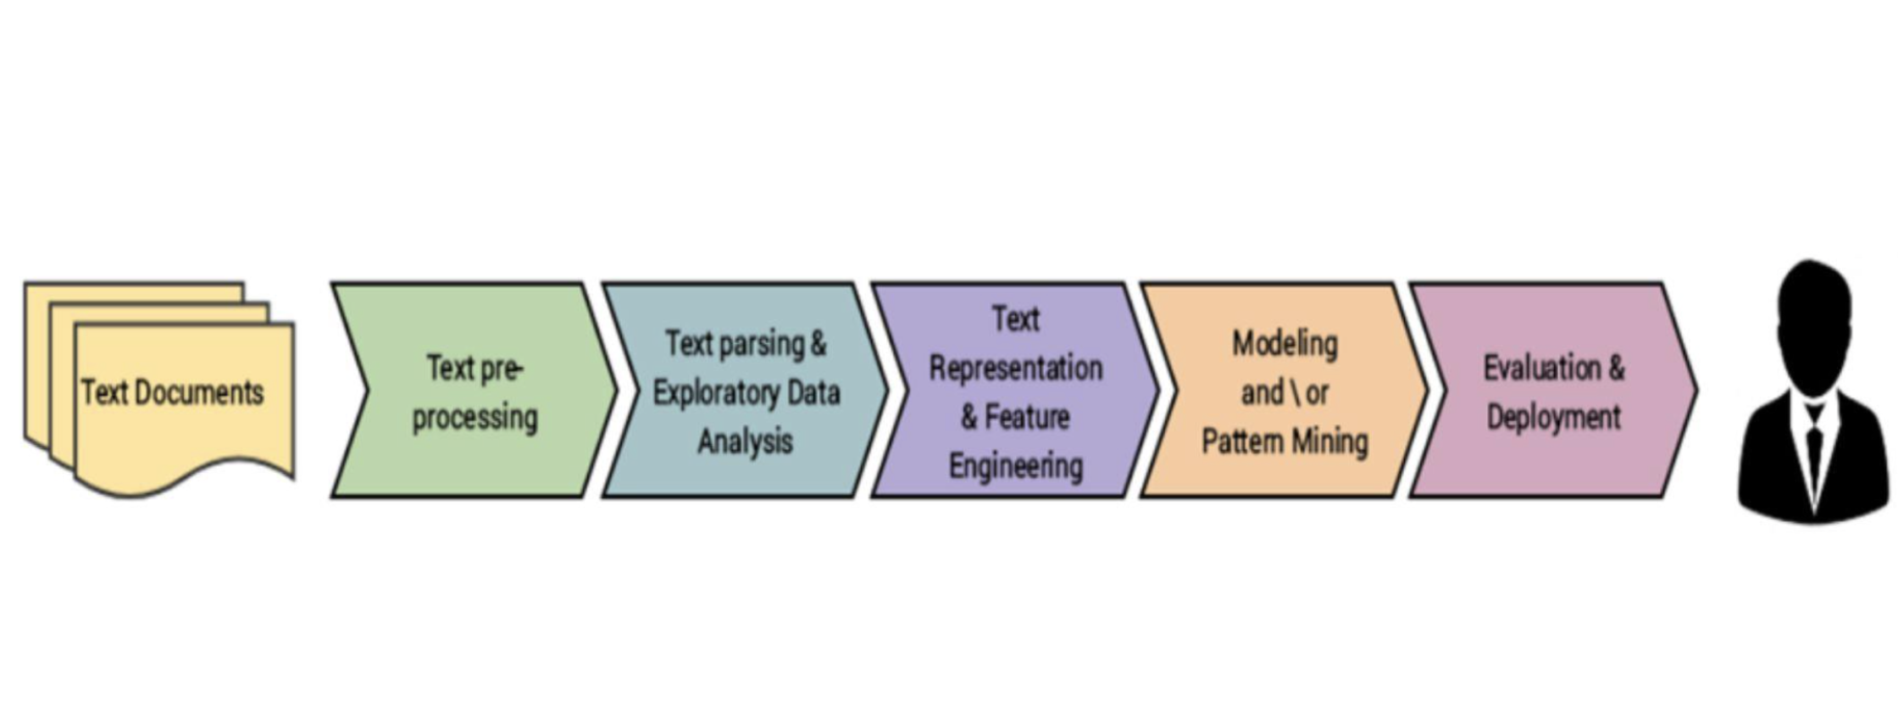
NLP Workflows

Slide 12
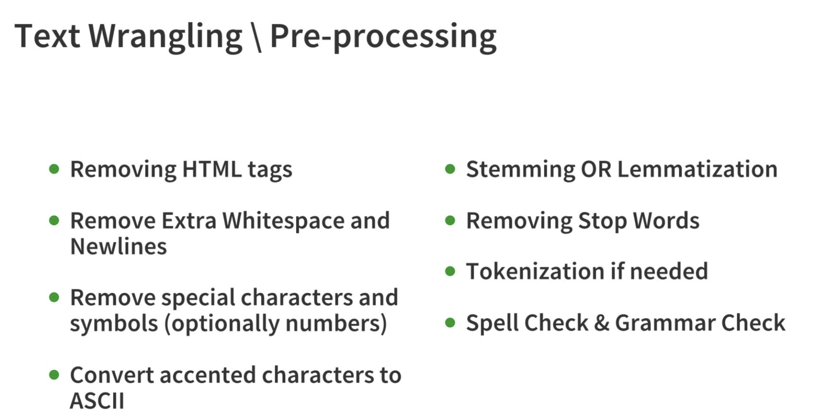
NLP Workflows

Slide 13
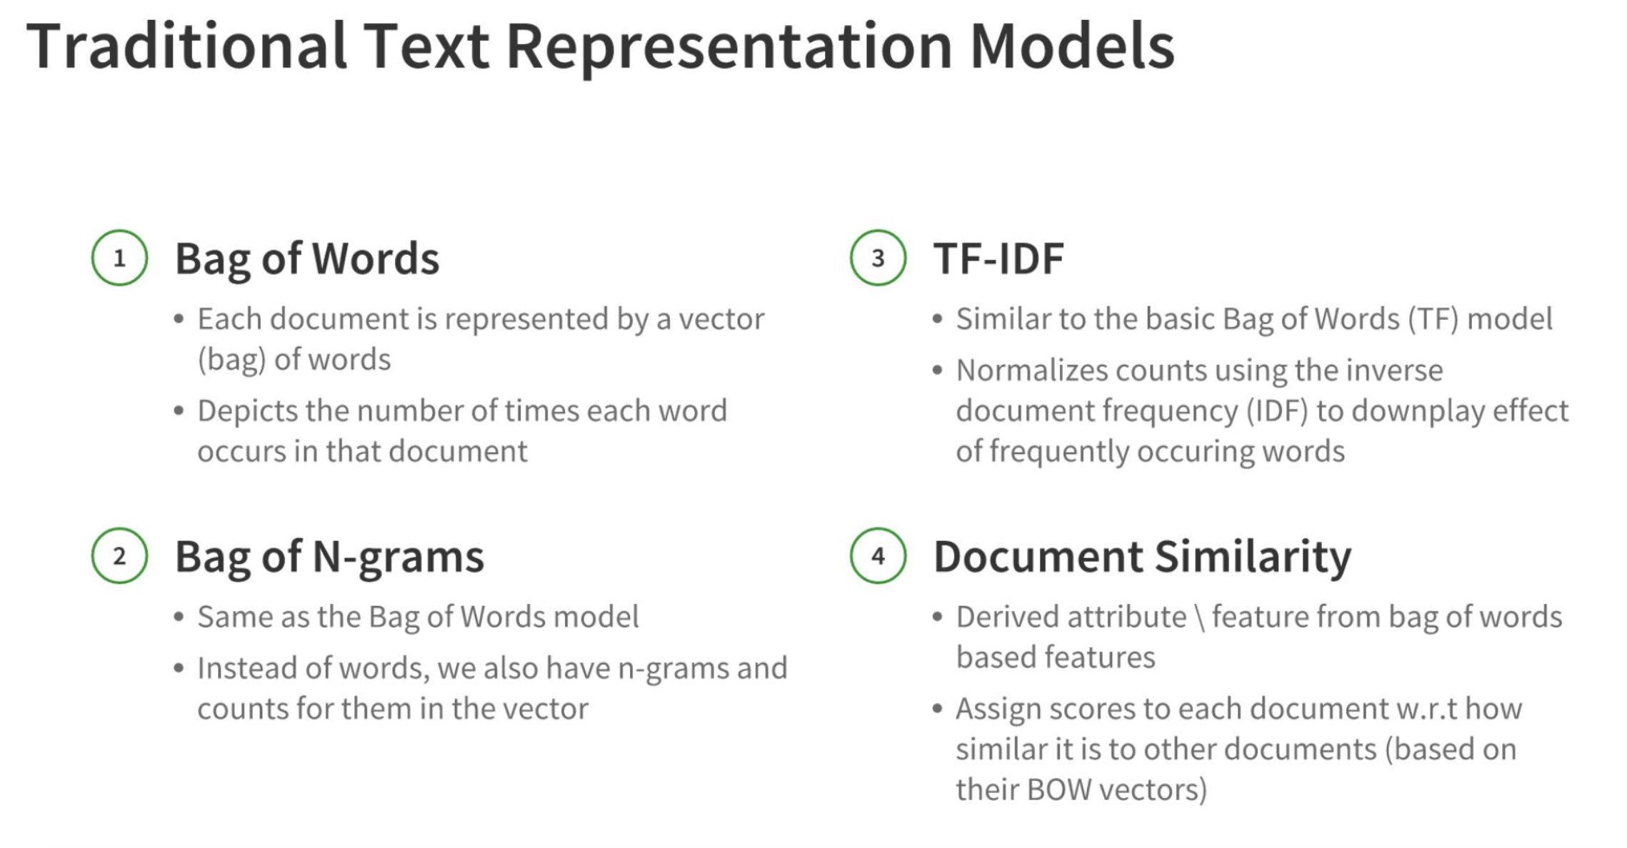
NLP Workflows

Slide 14
Quick Hands-on

Slide 15
NLP and Deep Learning
Words are not discrete symbols -> context is important
Interactions may or may-not be local

Slide 16
NLP and Deep Learning
Attention is all you need
Transformers
BERT and its Friends

Slide 17
Let Us Stay Connected
LinkedIn
GitHub
Website

Slide 18
References
https://storage.googleapis.com/deepmind-media/UCLxDeepMind_2020/L7%20-%20UCLxDeepMind%20DL2020.pdf

